Slide 1
Comenius diary
spain

Slide 2
The first day
On Thursday morning our Polish Comenius group met at the airport. Our plane took off at 10:30 AM and landed in Madrid at 2:00 PM.
Mr Ivan Lopez – the teacher from Talavera welcomed us warmly at Madrid airport.All together we went to meet the group from France.
Next we went to sightsee the capital together with the German. We had Spanish snacks TAPAS.
It was delicious! After that we went sightseeing and shopping. About 9:00 PM we were ready to go to Talavera de la Reina and meet our hosting families.

Slide 3
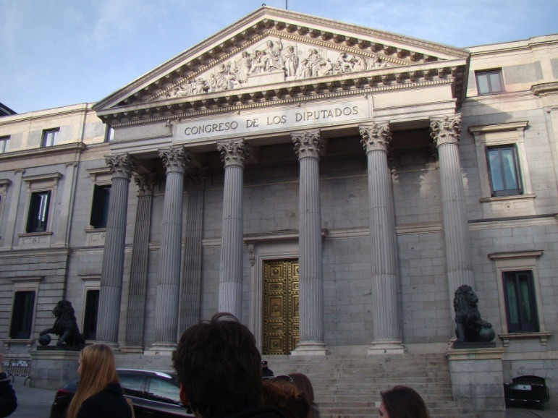
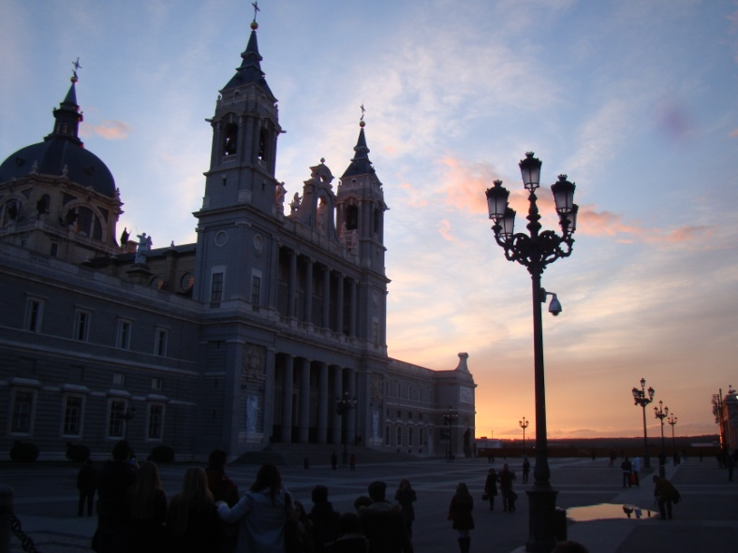
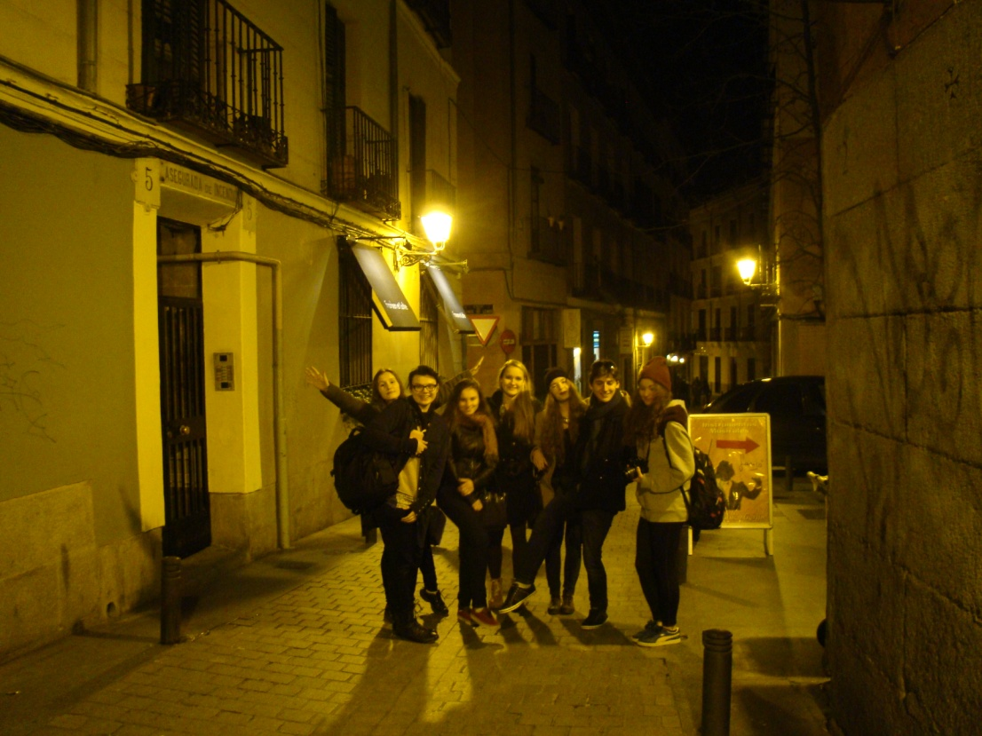

Slide 4
The second day
On Friday morning we started our integration activities which were led by Mr Anthony Schooling from France. Later every group presented their schools and Comenius projects. After our hard work we had a break and we got delicious CHURROS with hot chocolate. Later we were invited to the Town Hall and we met the Talavera’s mayor. Next we went sightseeing Talavera and shopping admiring the beautiful streets. In the evening we had free time which we spent with the hosting families.

Slide 5
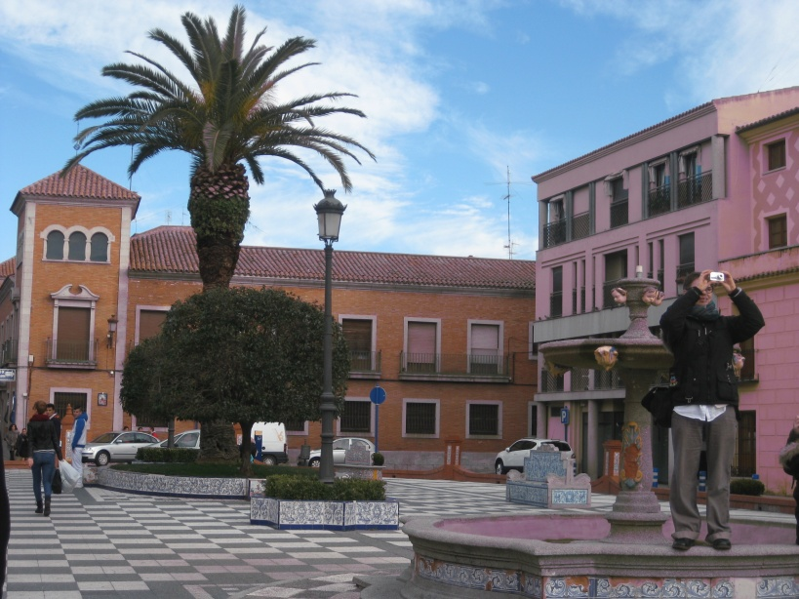
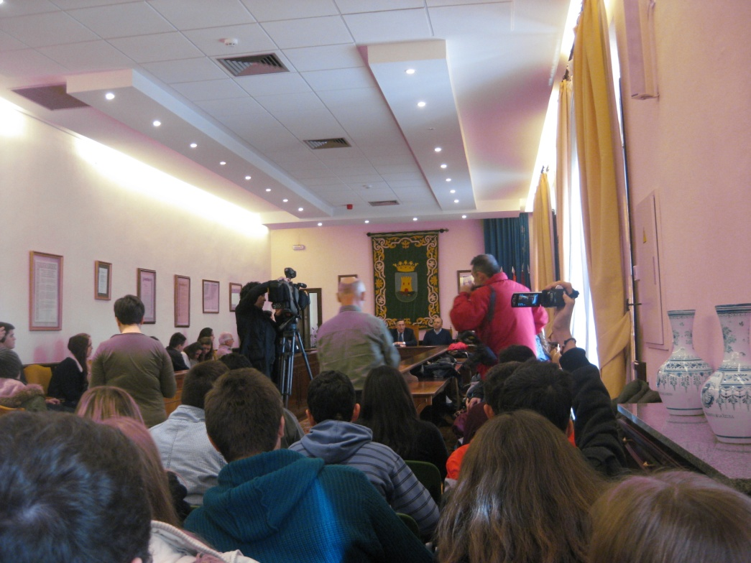
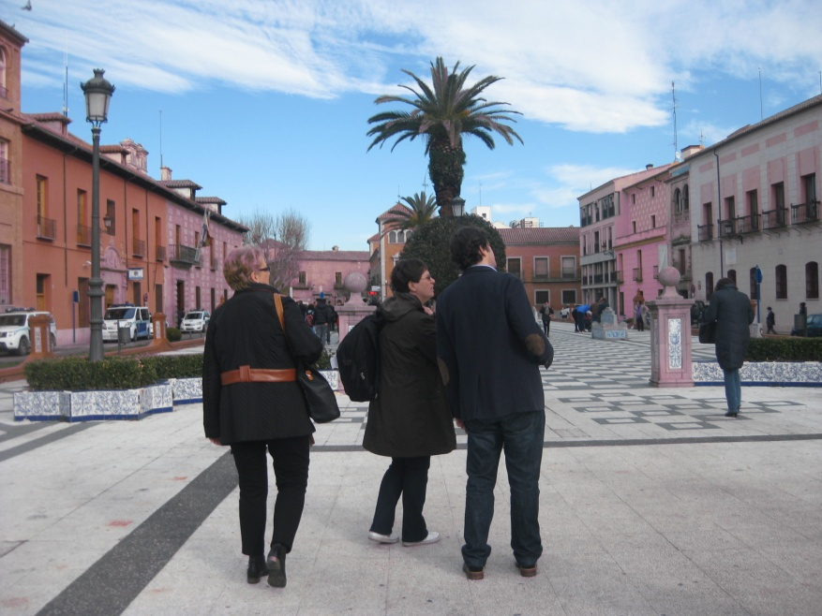

Slide 6
The third day
On Saturday morning we also had activities. We were divided into groups and we were talking about the objects that we want to redesign in our towns.
Next we ate traditional Spanish food which was made by the students and teachers - YUMMY! Later that day we all had free time and we hanged out all together.

Slide 7
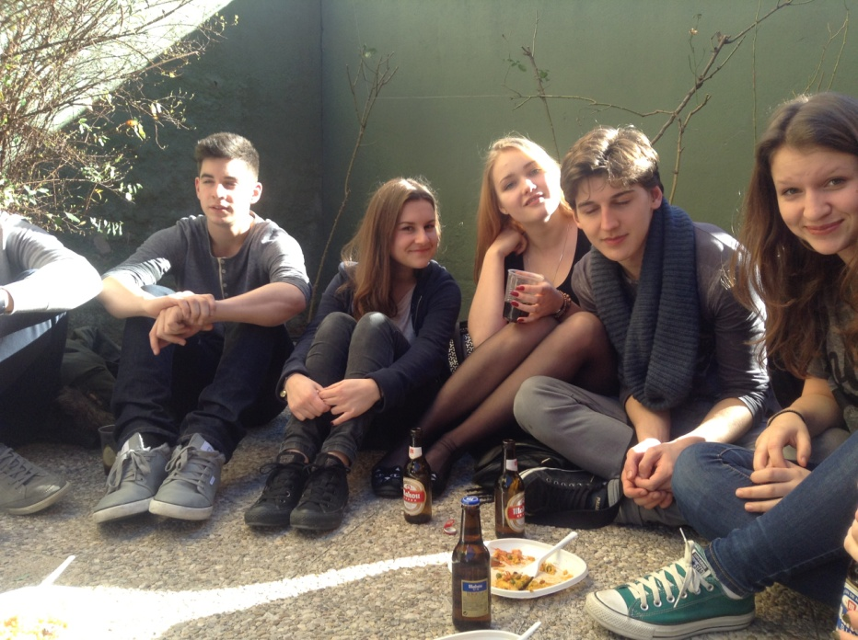
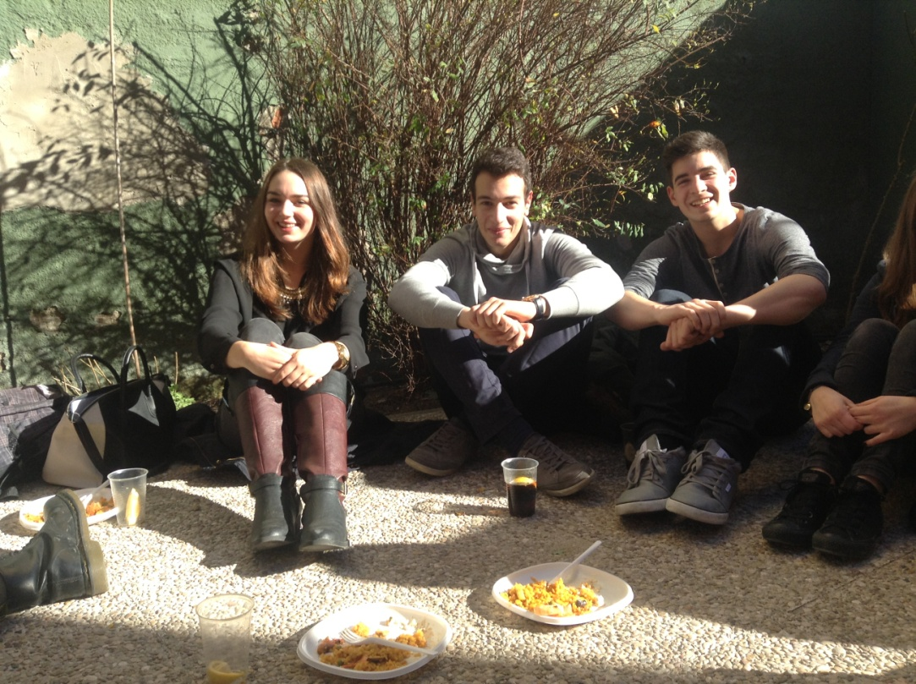

Slide 8
The fourth day
That day was a little bit different cause we woke up a bit later than usual and we had a whole-day-trip to Toledo – the former capital of the province. We visited the Cathedral and the museum there.
When we came back we went bowling and had free time.
Sadly we had to pack our luggage that evening. ☹

Slide 9
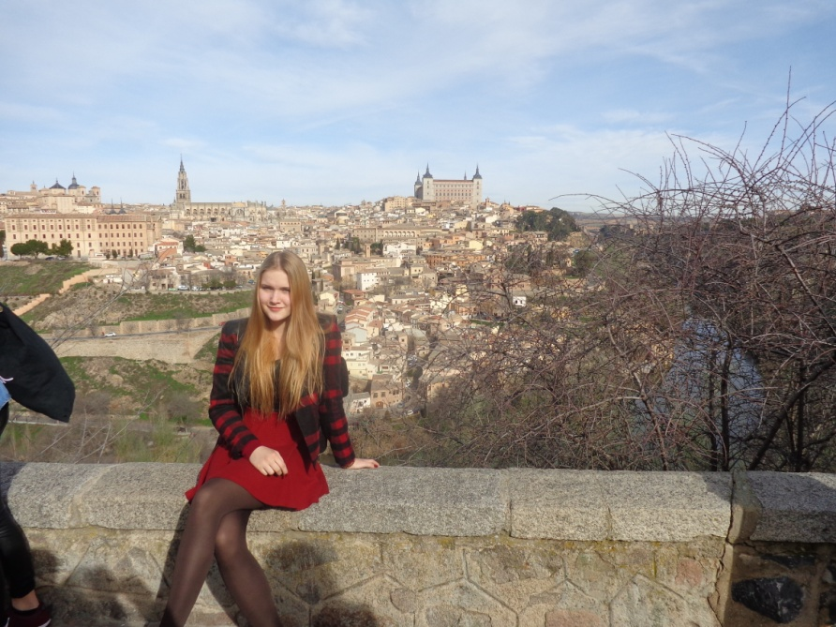
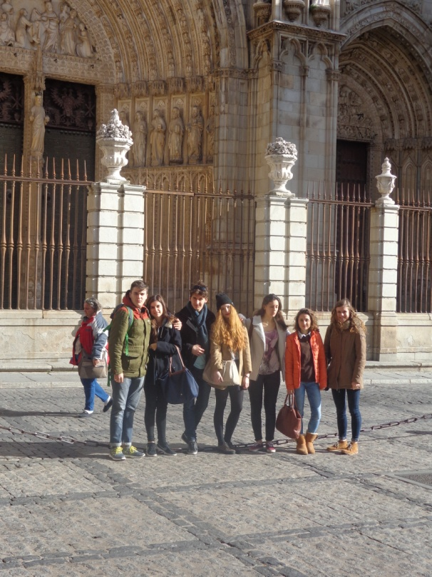
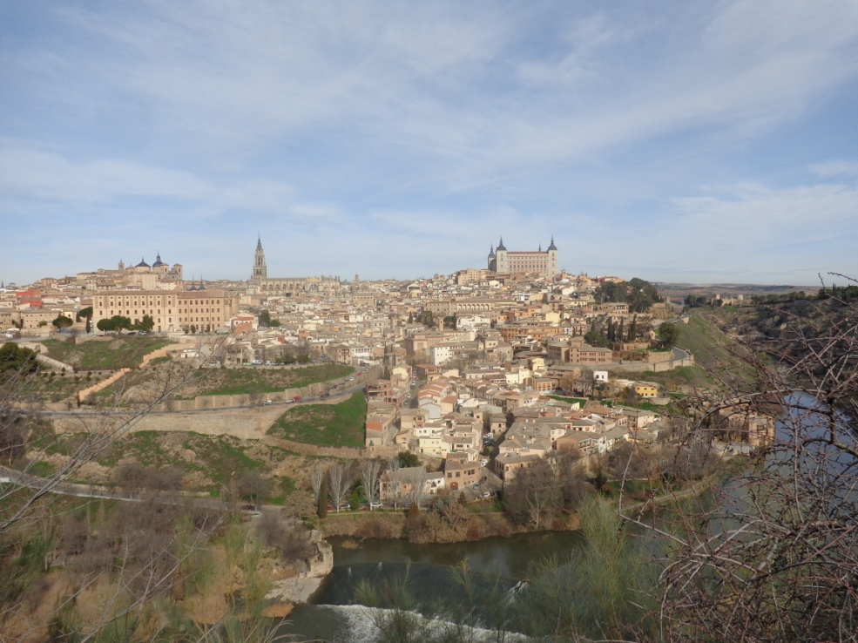

Slide 10
The fifth and last day
That morning we said good-bye to hosting families from Talavera and we went to Madrid. There we had some free time for the last shopping. Sadly we had to farewell the German and French group as we couldn’t spend more time together and then we drove by train to the airport. The plane to Poland took off at 3:00 PM and landed in Warsaw at about 7:00 PM. The end of the day and the end of
unforgettable trip. ☹

Slide 11
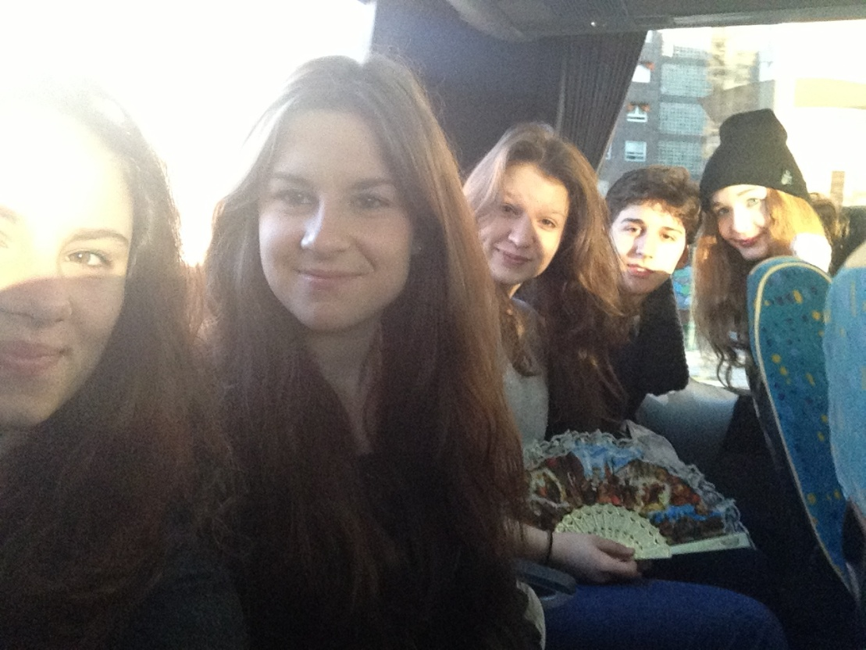
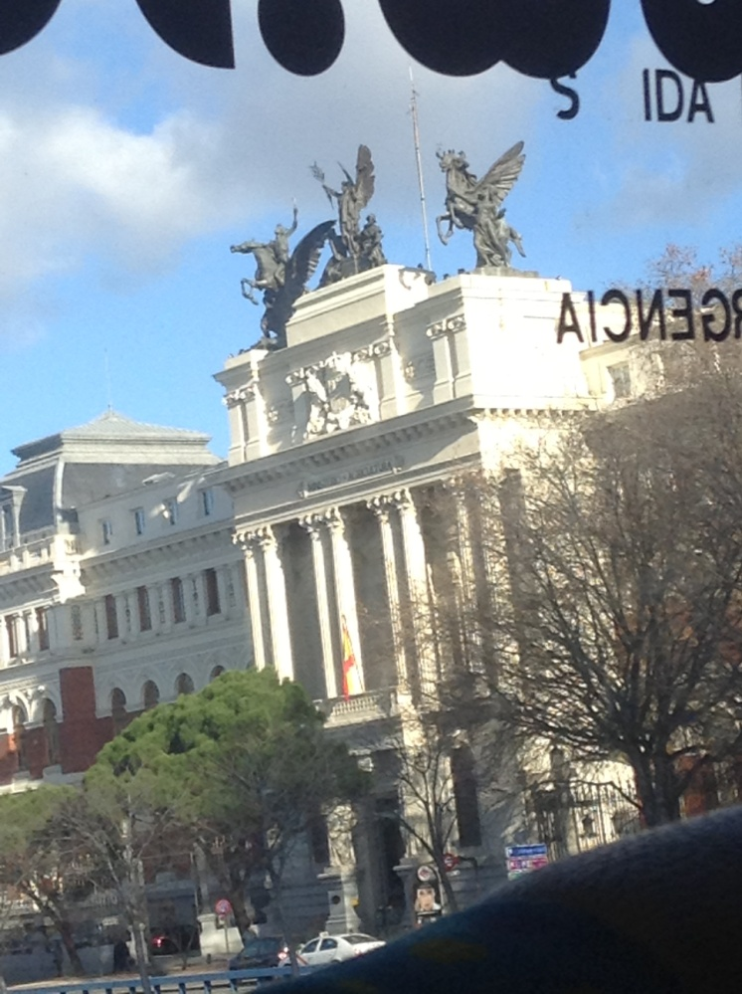

Slide 12
