Slide 1
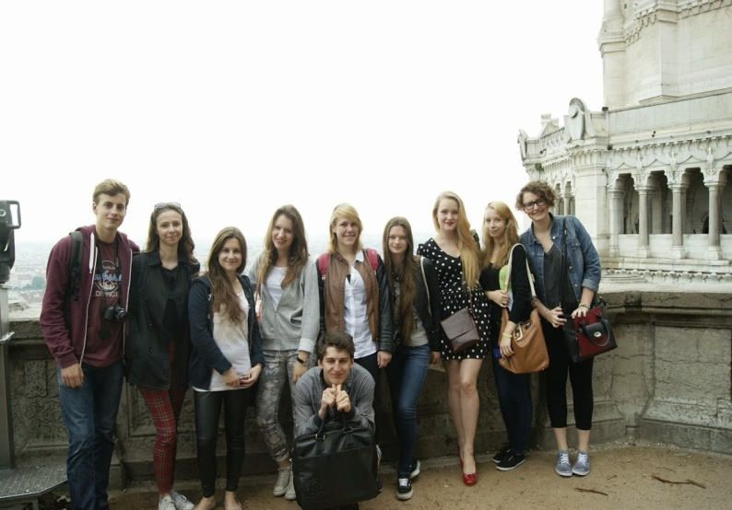
Lyon 23.05 -27.05 2014
During the time we spent in Lyon many things happened. We met new people and worked together on a project. Also, we saw Lyon, which we loved. French students showed
us the most interesting and beautiful places, like the antique theatre, the monumental church Notre-Dame de Fourvière, St John’s Cathedral. We had a great time with our host families, especially The Mother’s Day, which we spent together. When the final day of our stay finally arrived we were very upset, because we would like to stay a little bit longer. We said goodbye to everyone and came back to Warsaw, hoping that we would see each other again.
Now we are preparing to welcome other students in our school. We want you to have a great time in Warsaw. That is why we have planed very interesting trips which include visiting the most important places in our city. Also, we are working on a project to make everything as perfect as possible. We can’t wait for you to come. ☺

